Slide 1


Slide 2


Slide 3
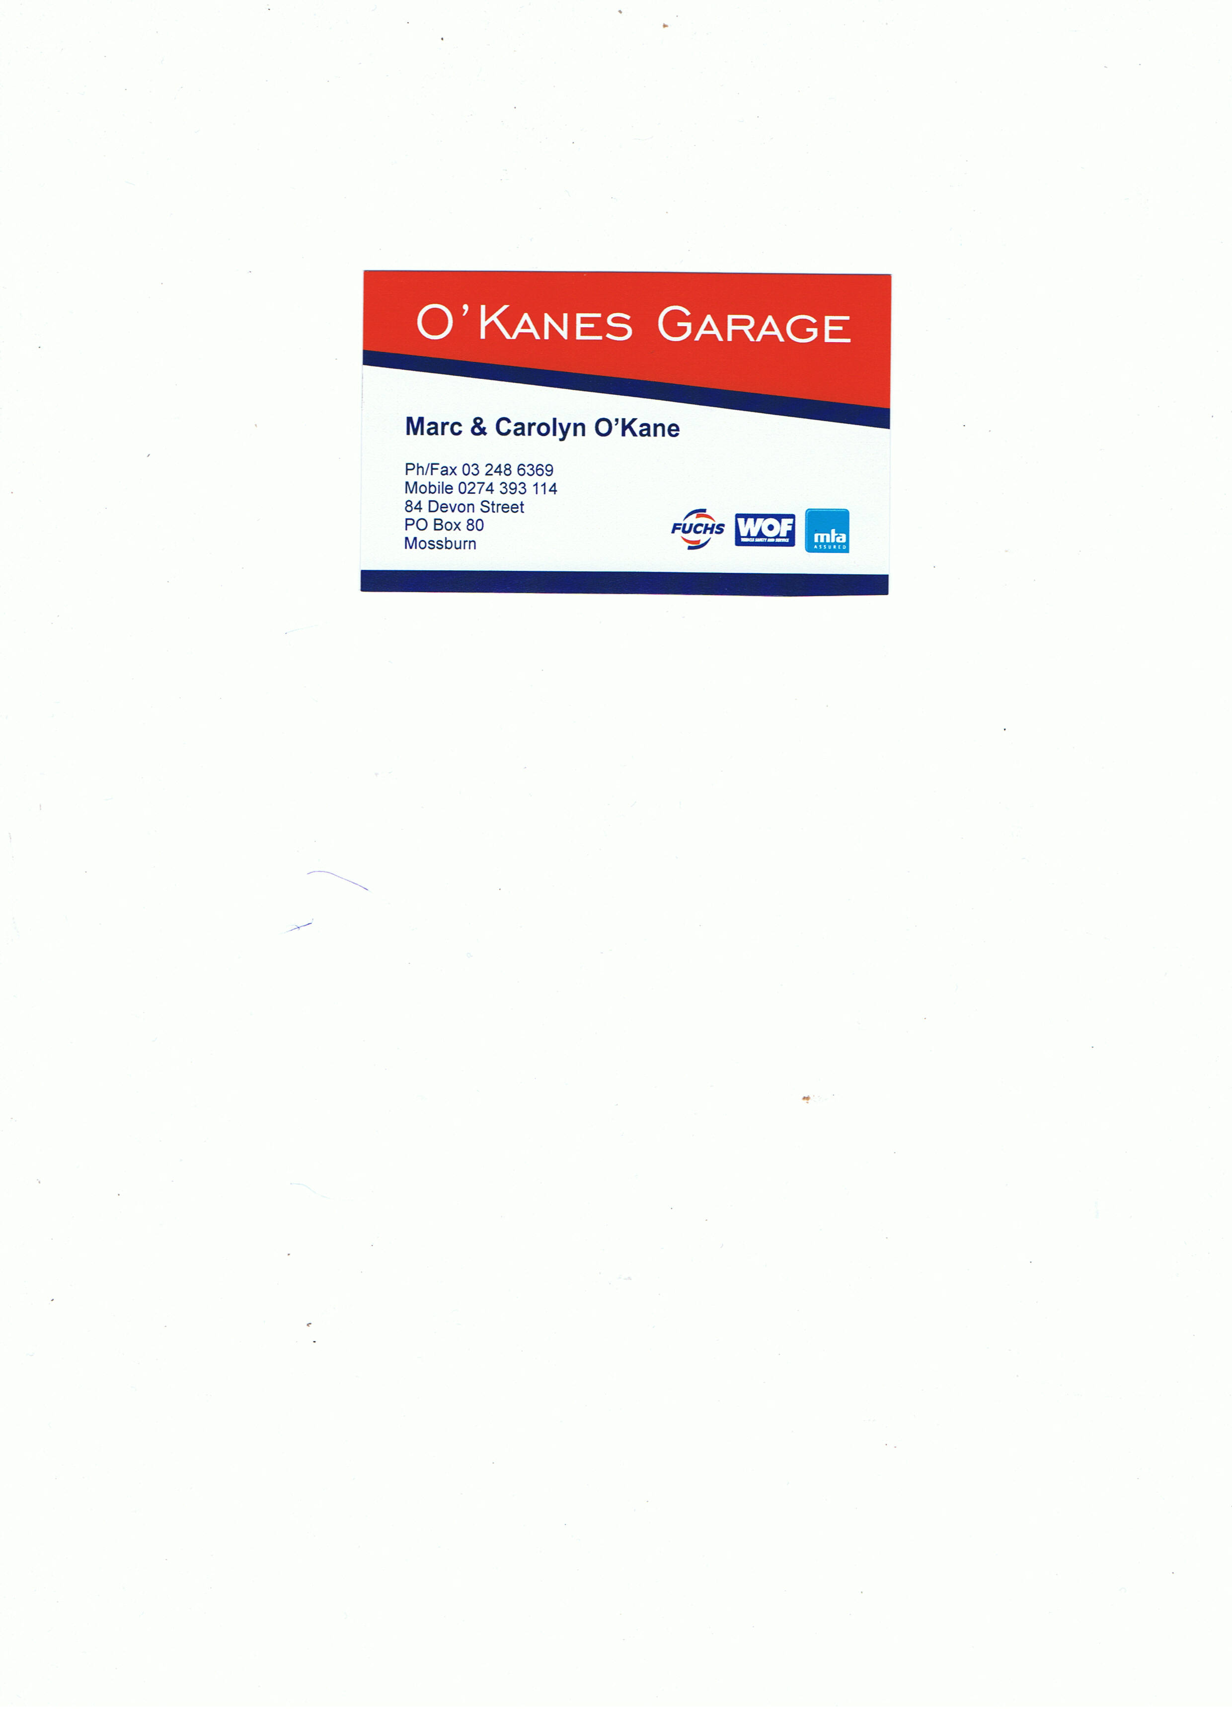

Slide 4
MOSSBURN COMMUNITY SWIMMING POOL

Slide 6


Slide 7


Slide 8


Slide 9


Slide 10


Slide 11
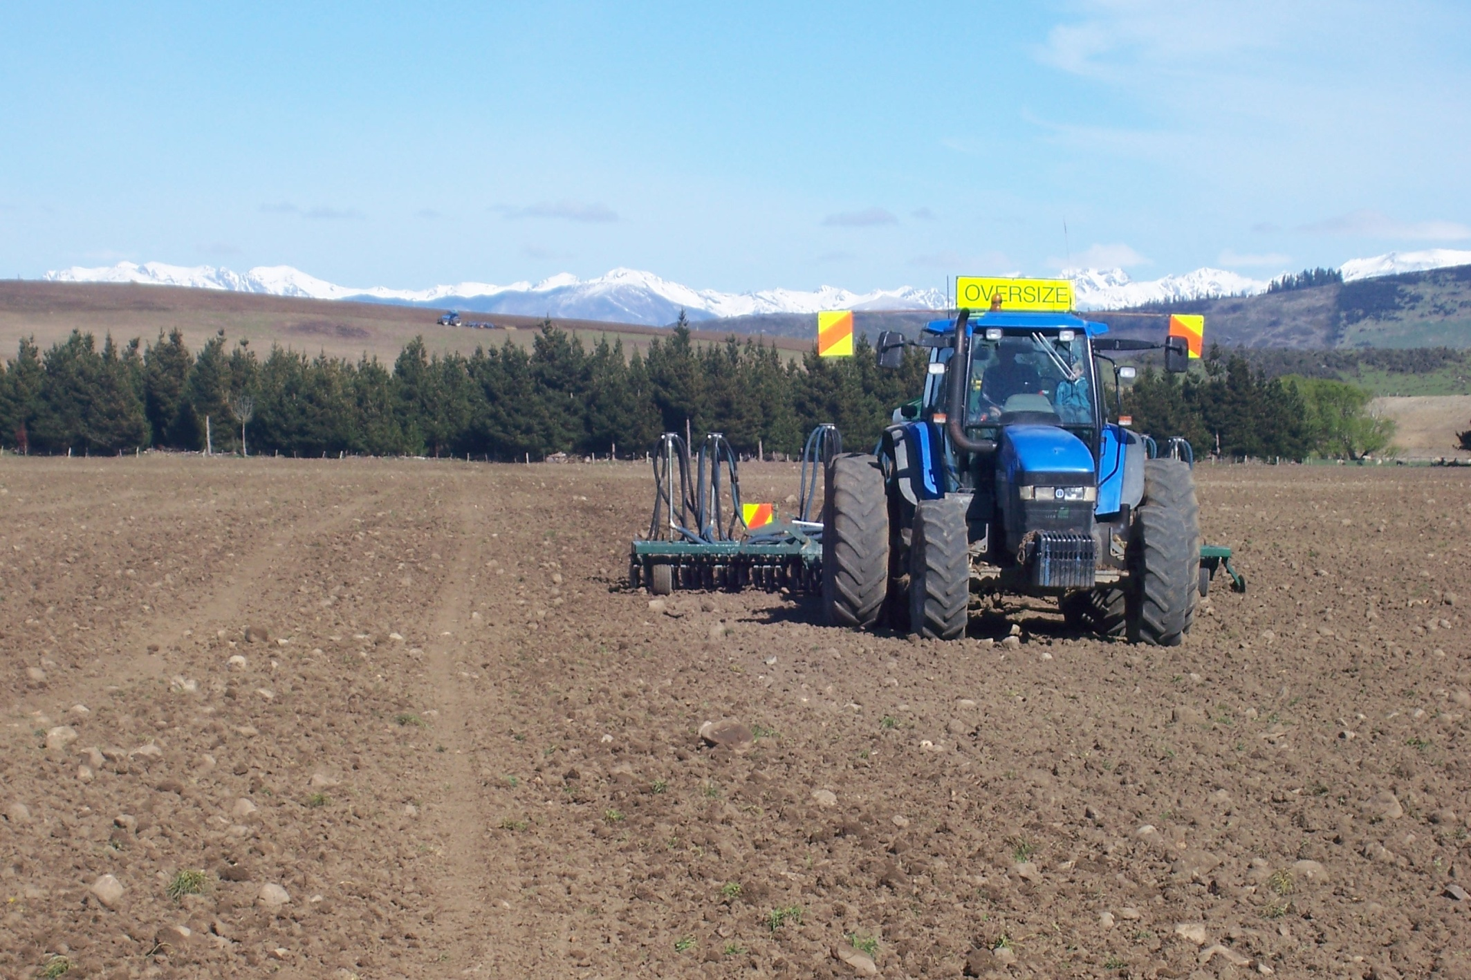
KEYSE CONTRACTING
Agricultural Cultivation
Ph: 03 2486465 or 027 2051988

Slide 12
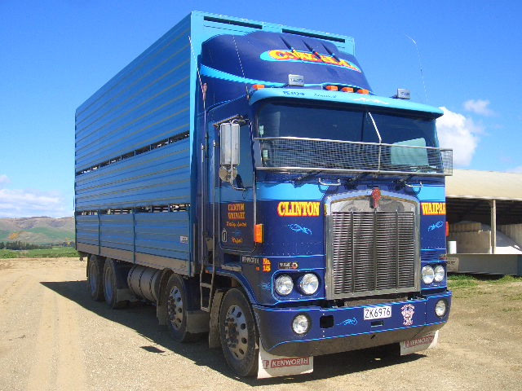


CLINTON WAIPAHI HOLDINGS LTD
Phone No Waipahi: (03) 205 8870
Phone No Clinton: (03) 415 7103
Phone No Lumsden: (03) 248 7487

Slide 15
TeAnau

Slide 17


Slide 18


Slide 19


Slide 20


Slide 21


Slide 22


Slide 23


Slide 24


Slide 25


Slide 27
HEENAN FAMILY
MOSSBURN

Slide 28


Slide 29

Te Anau

Slide 30

LUMSDEN

Slide 31
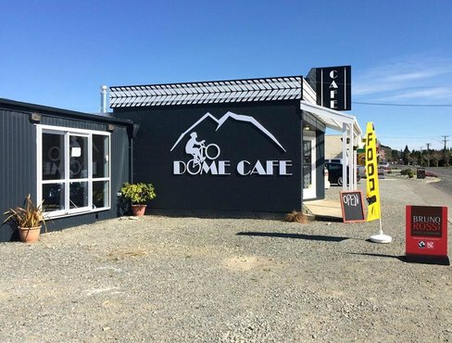
Mossburn

Slide 32
MCBRIDE FAMILY
TE ANAU

Slide 33

Invercargill

Slide 34

0800 15 15 15

Slide 35

0800 524 555

Slide 36

Call us on 03 211 1000

Slide 37


Slide 38

03-248 6399

Slide 39
Added Energy
Lumsden

Slide 40


Slide 41


Slide 42


Slide 43


Slide 44
Castlerock
Contracting
Mossburn

